Slide 1
Classifying Loan Approvals Using SVM in R

Slide 2
Project analysis slide 2
Intro to Problem
Objective: Classify whether or not a loan will be approved.
Data is provided for 614 loans
Features are a mix of continuous and categorical
Many missing values for both types will need to be addressed

Slide 3
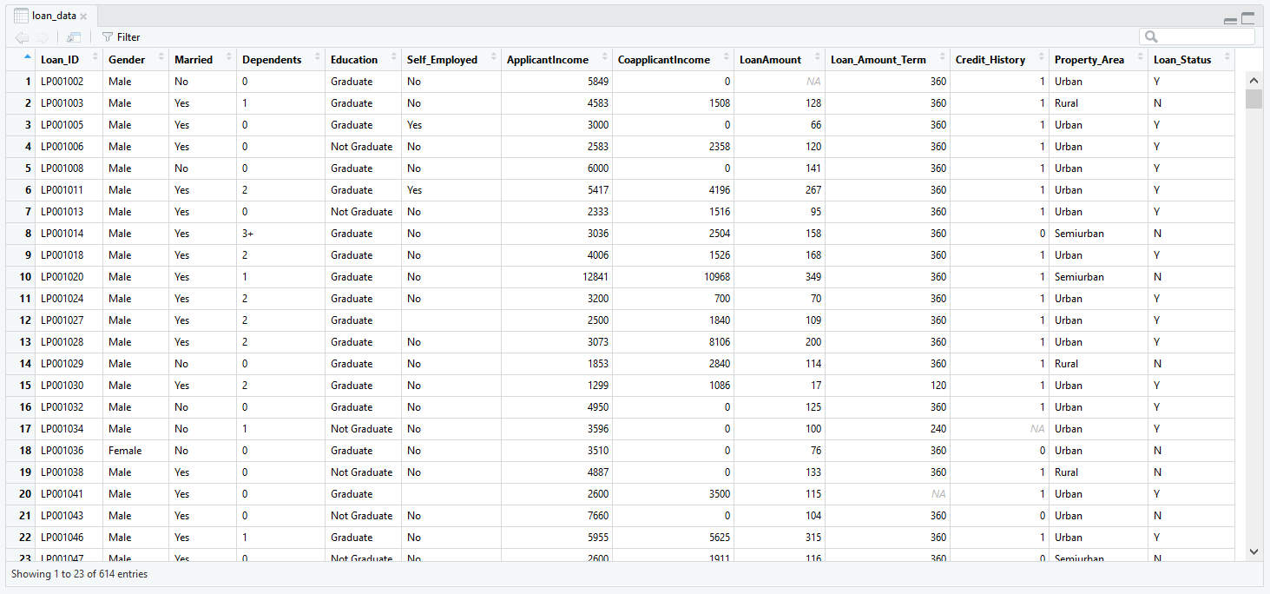
Project analysis slide 2
Intro to Data

Slide 4
Project analysis slide 2
Intro to Data
LoanID: Unique key for each loan
Gender: Male or Female
Married: Indicates if borrower is married
Dependents: Number of dependents borrower has
Education: Borrower’s highest level of education
Self_Employed: Indicates if borrower is self-employed
Credit_History: Indicates if borrower’s credit rating meets criteria
Property_Area: Urban, Suburban, or Rural
Loan_Status: Indicates if the loan was approved; response variable

Slide 5
Project analysis slide 2
Intro to Data
ApplicantIncome: Borrower’s monthly income
CoapplicantIncome: Co-borrower’s monthly income (zero if no co-borrower)
LoanAmount: Amount of the loan, in thousands of $
Loan_Amount_Term: Length of the loan in months

Slide 6
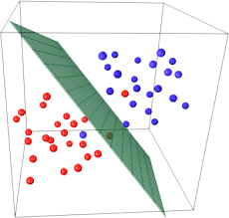
Project analysis slide 2
Modeling Approach
Support Vector Machine
Simple yet powerful
Assumption that a small number of features will dominate classification

Slide 7
Project analysis slide 2
Outline of Project
Imputing Missing Values for Categorical Variables
Imputing Missing Values for Numerical Variables
Feature Engineering and Additional Processing
Initial Modeling
Feature Selection via Backwards Selection

